Slide 1
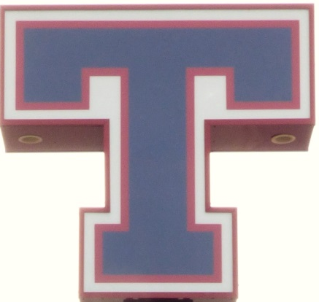


ARK TALK :
Mr.
Why should I WORK with my School Counselor?

Slide 2
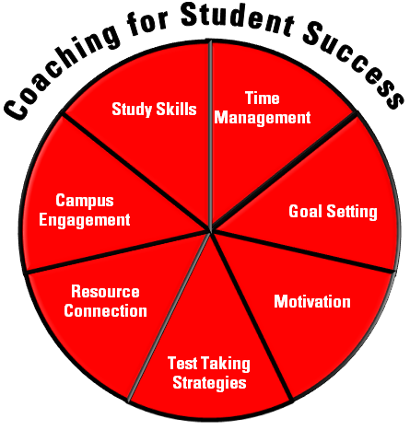



Slide 3
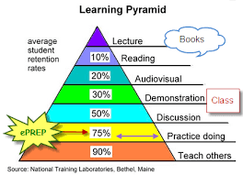
What does it take to become a lifelong learner?
Your school counselor can help find your learning style!

Slide 4


Helpful sites for test prep
March2Success
https://www.march2success.com/register/index?params=mID165599239|Tarkowsk
Varsity Tutors
https://www.varsitytutors.com/practice-tests

Slide 5

Your school counselor can help you create your unique 4-year plan

Slide 6
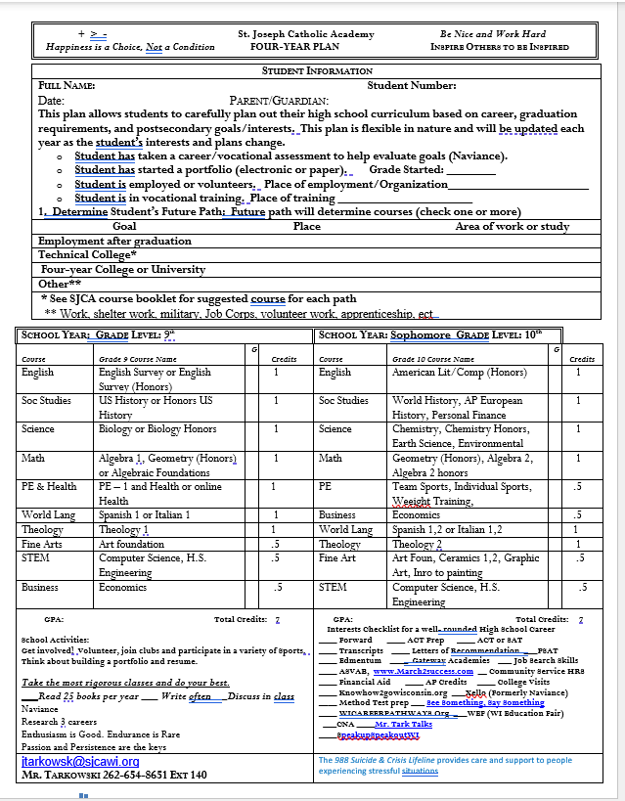

Slide 7
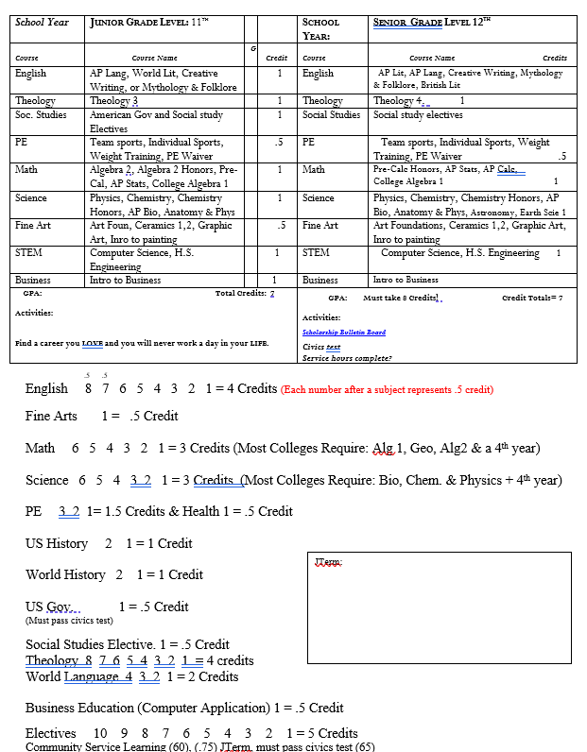

Slide 8






Slide 9

Naviance
Explore: your interests
Know: yourself and opportunities
Plan: courses and connections
Go: to job or college experiences

Slide 10
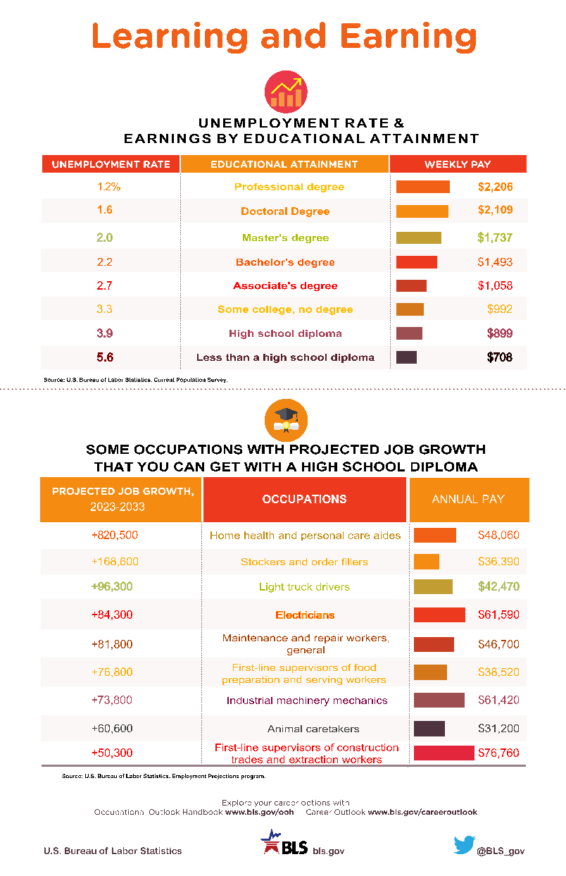

Slide 11
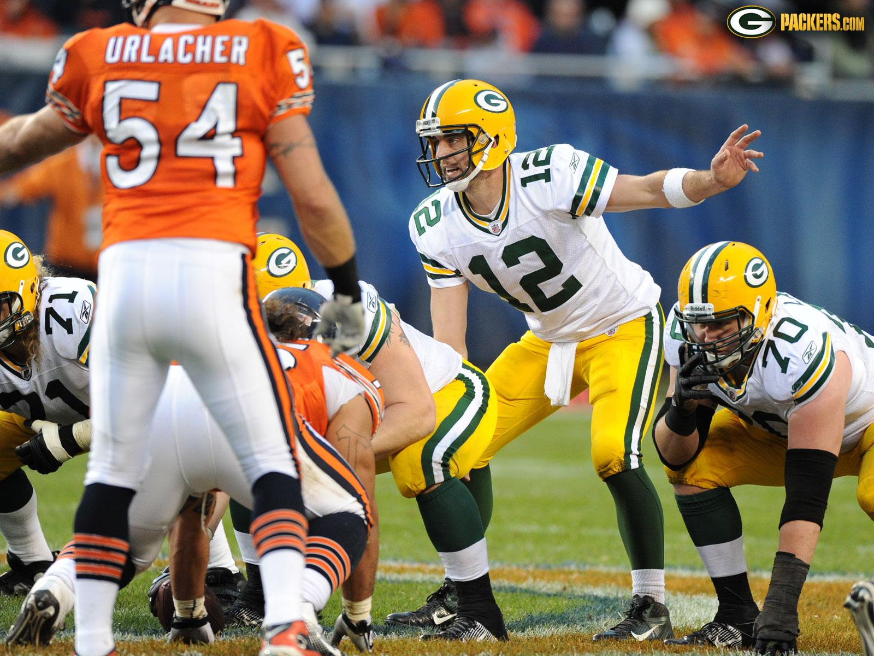
CHANCE OF PLAYING PRO BALL
Why is Academic Success and Decision Making so IMPORTANT?
1,023,712 100%
are playing High School Football
61,000 6%
will play at the Collegiate level
6,000 .6%
will be scouted by the NFL
875 .08%
will sign an NFL contract
1,023,412 99.7%
H.S. players will NOT play in NFL
.03% 300 will make NFL roster
nflplayerengagement.com
Career Length: 6 years if rookie player makes a roster MLB: 5.6 Yrs (2010)
NFL 9.3 years if player is a first round pick NBA: 6 Yrs (2010)
11.7 if you player plays in a Pro-bowl NBA Retirement age: 28

Slide 12

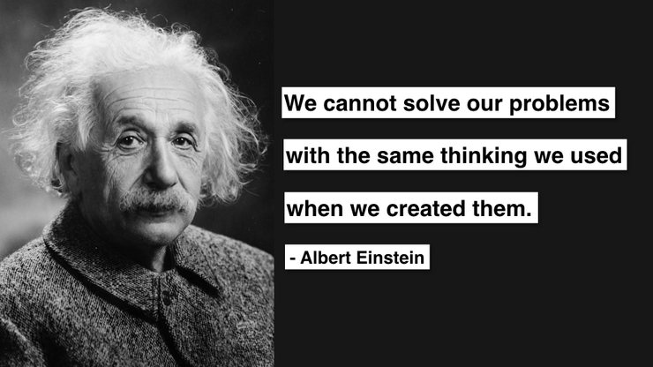


Slide 13

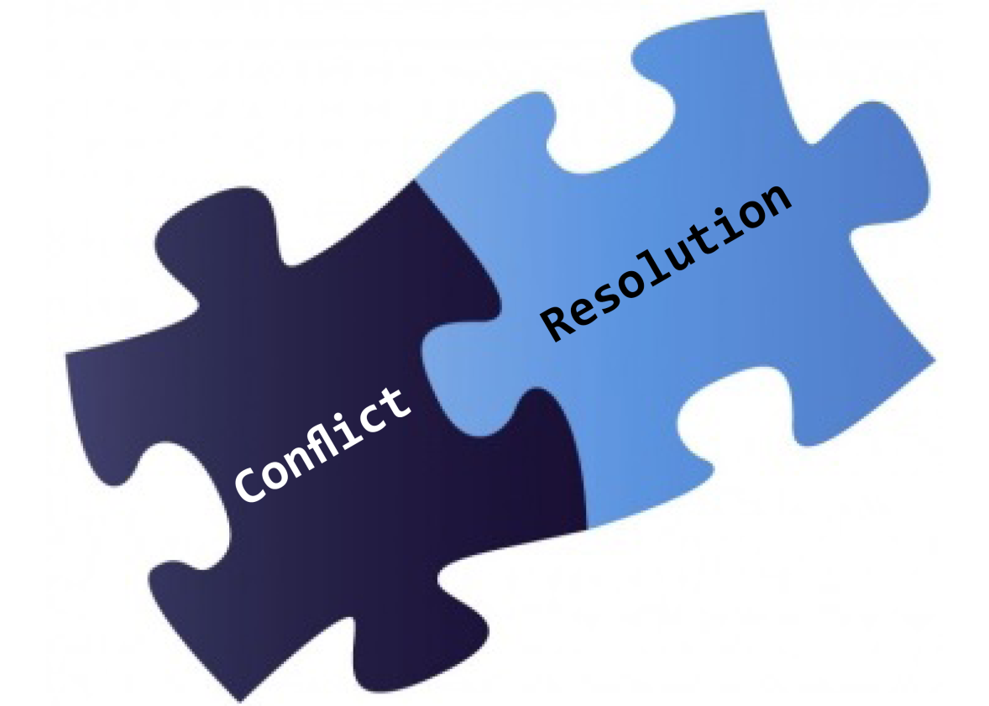

Social Emotional Learning
Community Resources

Slide 14


Slide 15
Helpful Links
U.S. Bureau of Labor Statistics Career Exploration
UWHelp Information on Appling to College (Seniors)
Collegeboard College information, college search, SAT Testing information (Juniors and Seniors)
Actstudent.org. ACT testing information (Juniors and Seniors)
Fastweb Scholarship search (Seniors)
FAFSA. Federal Student Aid (Seniors)
Letter of Recommendation Use this link to help people write a letter of recommendation for you.
Varsity Tutors Test prep help
Writing a college essay CLICK HERE
Best scholarship websites CLICK HERE
Study Tips CLICK HERE
Coach Tark Talks
13. Get more info on the trades: Trade Contact Information Trade Wages and Benefits

Slide 16

s

Slide 17




